Slide 1


Slide 2
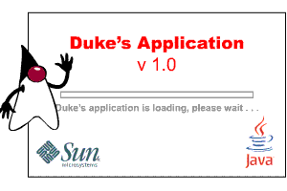

Slide 3
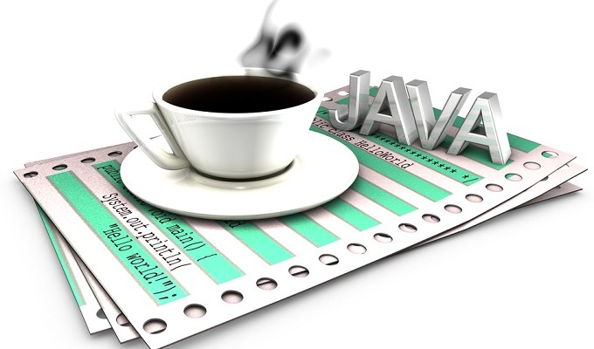
Compiled by:
IKNOOR SINGH
CSE-02
07313202711

Slide 4

Paradigm(s) | multi-paradigm: object-oriented, structured,imperative, generic,reflective
Appeared in | 1995^{[1]}
Designed by | James Gosling and Sun Microsystems
Developer | Oracle Corporation
Stable release | Java Standard Edition 7 Update 40 (1.7.40) (September 10, 2013; 24 days ago)
Typing discipline | Static, strong, safe,nominative, manifest
Major implementations | OpenJDK, many others
Dialects | Generic Java, Pizza
Influenced by | Ada 83, C++, C#,^{[2]} Eiffel,^{[3]}Generic Java, Mesa,^{[4]}Modula-3,^{[5]} Oberon,^{[6]}Objective-C,^{[7]} UCSD Pascal,^{[8][9]} Smalltalk
Influenced | Ada 2005, BeanShell, C#,Clojure, D, ECMAScript,Groovy, J#, JavaScript,PHP, Python, Scala, Seed7,Vala
Implementation language | C and C++
OS | Cross-platform (multi-platform)
License | GNU General Public License, Java Community Process
Usual filename extensions | .java, .class, .jar

Slide 5

INTRODUCTION TO JAVA
Java is a general-purpose, concurrent, class-based, object-oriented computer programming language that is specifically designed to have as few implementation dependencies as possible. It is intended to let application developers "write once, run anywhere" (WORA), meaning that code that runs on one platform does not need to be recompiled to run on another.
The language derives much of its syntax from C and C++, but it has fewer low-level facilities than either of them.
Java applications are typically compiled to bytecode (class file) that can run on any Java virtual machine (JVM) regardless of computer architecture.

Slide 6



of
In 1991, Sun Microsystems was attempting to develop a new technology for programming next generation smart appliances.
The original plan was for the Star7 operating system to be developed in C++ but rejected the idea for several reasons.
As a result we have new language that was better for the purposes of the Green project than C++ developed by Gosling.
He called the language Oak in honor of a tree that could be seen from his office window.
DUKE,JAVA MASCOT

Slide 7
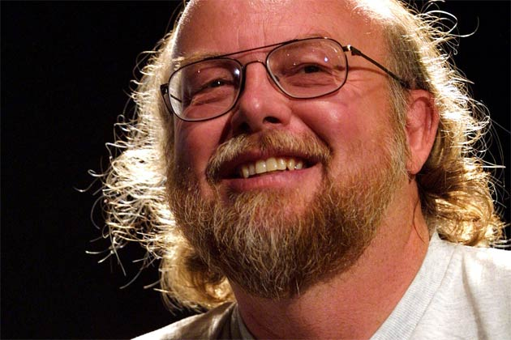
James Gosling was part of Green, an isolated research project at Sun that was studying how to put computers into everyday household items like thoughtful toasters, sagacious Salad Shooters and lucid lamps. The group also wanted these devices to communicate with each other.
So The Greens built a prototype device called Star7. This gadget was a handheld remote control operated by touching animated objects on the screen. The universe featured Duke-immortalized later as Java's mascot.
Sun found that Oak could not be trademarked because of a product already using the name.
After sessions in January 1995, The meeting, arranged by Kim Polese (marketing person) where about a dozen people got together to brainstorm with James Gosling, a vice president and fellow of Sun, and the author of Oak, the final suggest names were Silk, DNA, Ruby, WRL and Java by the team in meeting But the other names could not trademark.
So finally JAVA was the name chosen because it sounded the coolest and decided to go ahead with it and name was first suggested by Chris Warth.
-

Slide 8
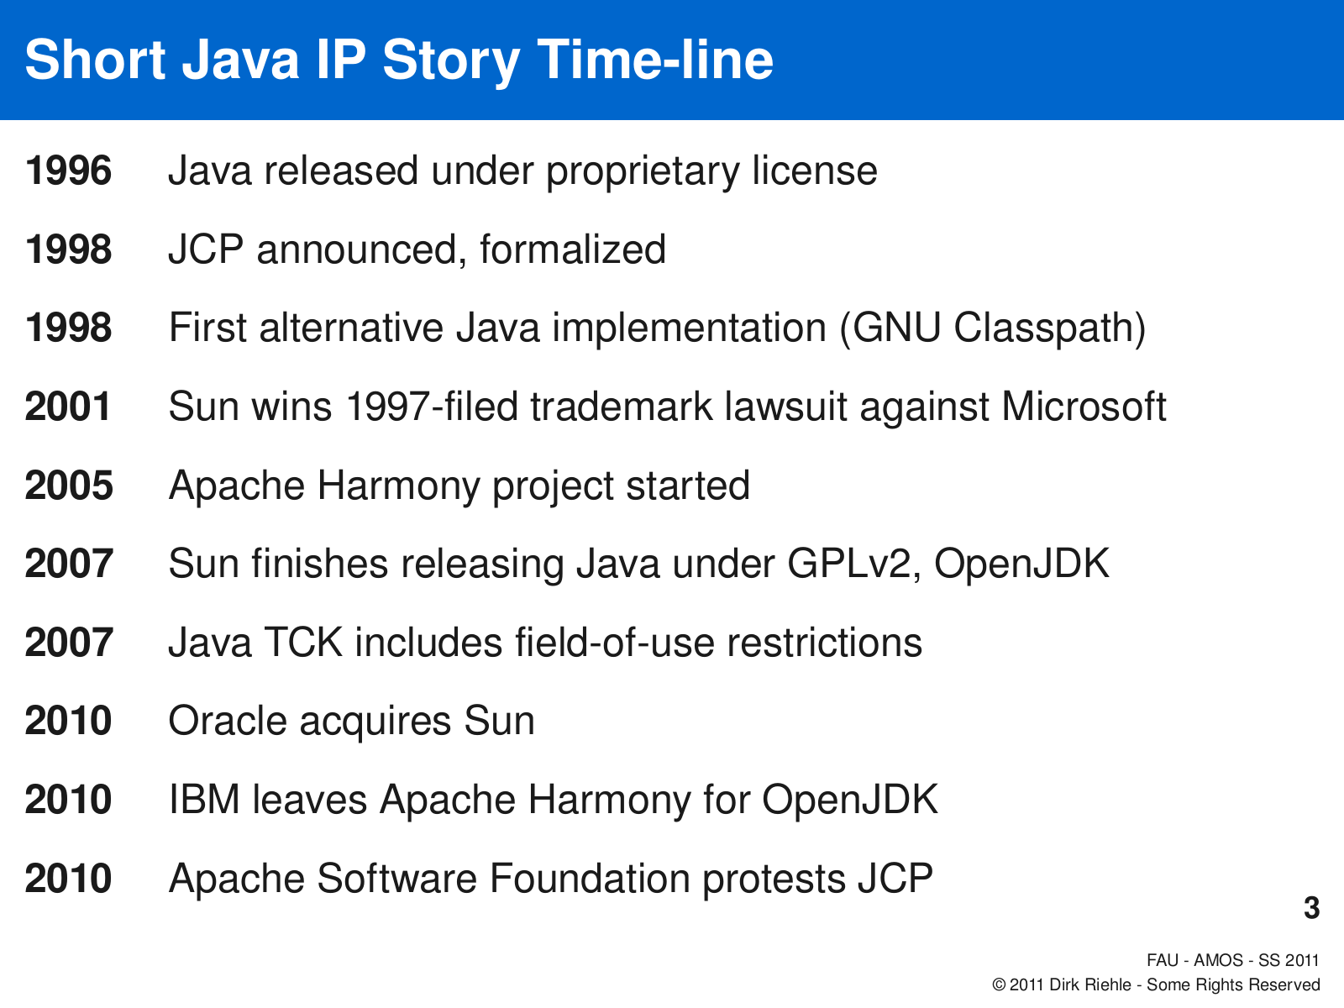

Slide 9

Versions of java
Versions of java
Java SE 7 (July 28, 2011
Java SE 6 (December 11, 2006)
J2SE 5.0 (September 30, 2004)
J2SE 1.4 (February 6, 2002
J2SE 1.3 (May 8, 2000)
J2SE 1.2 (December 8, 1998)
JDK 1.1 (February 19, 1997)
JDK 1.0 (January 21, 1996)

Slide 10

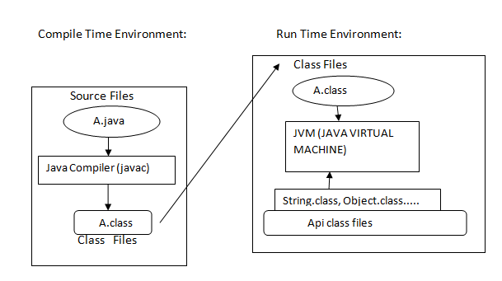
JAVA ENVIRONMENT

Slide 11
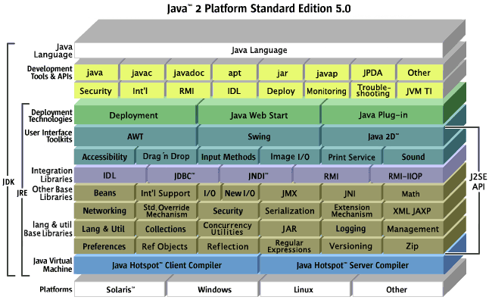
ARCHITECTURE OF JAVA

Slide 12
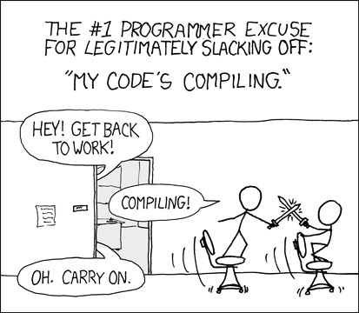
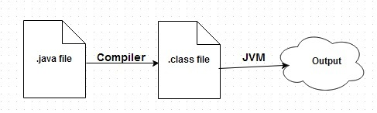
JVM
JVM stands for Java Virtual Machine and it runs or executes java compiled file(.class). It's main job is to load class files and execute the bytecode they contain. Below diagram shows the life cycle of a java program.
Sun Microsystems has stated that there are over 5.5 billion JVM-enabled devices

Slide 13
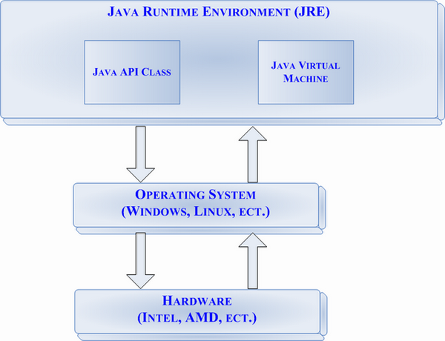
A Java virtual machine is a program which executes certain other programs, namely those containing Java bytecode instructions. JVM's are most often implemented to run on an existing operating system, but can also be implemented to run directly on hardware.
A JVM provides a run-time environment in which Java bytecode can be executed, enabling features such as automated exception handling, which provides root-cause debugging information for every software error (exception).
A JVM is distributed along with Java Class Library, a set of standard class libraries (in Java bytecode) that implement the Java Application programming interface (API). These libraries, bundled together with the JVM, form theJava Runtime Environment (JRE).

Slide 14
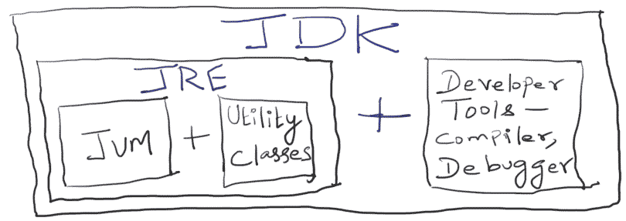
Subset OF
SDK
JDK
(java development kit)
The Java Development Kit (JDK) is an implementation of either one of the Java SE, Java EE or Java ME platforms^{[1]}released by Oracle Corporation in the form of a binary product aimed at Java developers on Solaris, Linux, Mac OS X orWindows.^{[2]}
Since the introduction of the Java platform, it has been by far the most widely used Software Development Kit (SDK).^{[citation needed]}
On 17 November 2006, Sun announced that it would be released under the GNU General Public License(GPL), thus making it free software. This happened in large part on 8 May 2007, when Sun contributed the source code to theOpenJDK.^{[3]}

Slide 15
OBJECT ORIENTED
simple
DISTRIBUTED
ARCHITECTURE NEUTRAL
FEATURES
OF
JAVA
MULTITHREADED
INTERPRETED
SECURE
ROBUST

Slide 16

Simple
Looks familiar to existing programmers: related to C and C++:
Omits many rarely used, poorly understood, confusing features of C++, like operator overloading, multiple inheritance, automatic coercions, etc.
Contains no goto statement, but break and continue
Has no header files and eliminated C preprocessor
Eliminates much redundancy (e.g. no structs, unions, or functions)
has no pointers
Distributed
Java is Distributed Language Means because the program of java is compiled onto one machine can be easily transferred to machine and Executes them on another machine So java is Specially designed For Internet Users which uses the Remote Computers For Executing their Programs on local machine after transferring the Programs from Remote Computers or either from the internet.
Distributed
It has a spring-like transparent RPC system
Now uses mostly tcp-ip based protocols like ftp & http
Java supports various levels of network connectivity through classes in the java.net package (e.g. the URL class allows a Java application to open and access remote objects on the internet).

Slide 17
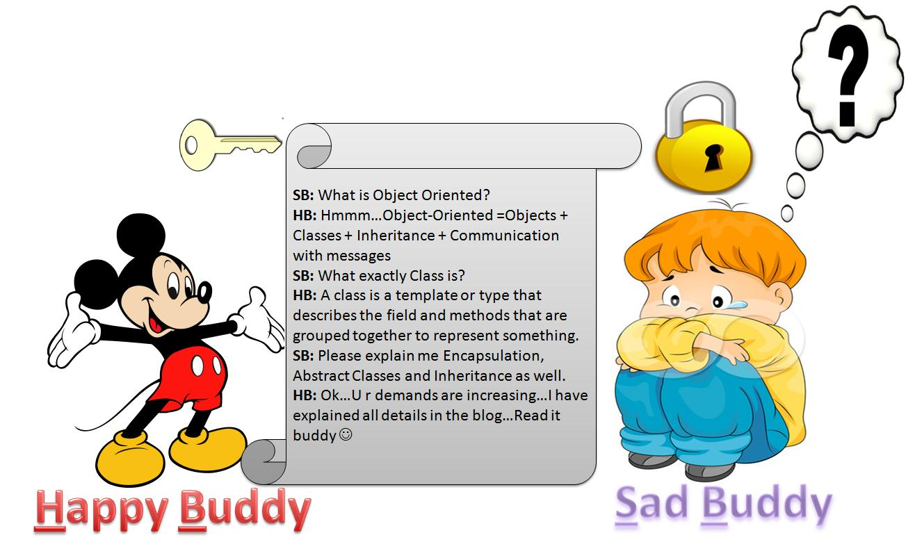
Object-Oriented

Slide 18
Java is an object-oriented language, which means that you focus on the data in your application and methods that manipulate that data, rather than thinking strictly in terms of procedures.In an object-oriented system, a class is a collection of data and methods that operate on that data.
Taken together, the data and methods describe the state and behavior of an object. Classes are arranged in a hierarchy, so that a subclass can inherit behavior from its superclass.
Java comes with an extensive set of classes, arranged in packages, that you can use in your programs.
Robust
Java has been designed for writing highly reliable or robust software:
language restrictions (e.g. no pointer arithmetic and real arrays) to make it impossible for applications to smash memory (e.g overwriting memory and corrupting data)
Java does automatic garbage collection, which prevents memory leaks
extensive compile-time checking so bugs can be found early; this is repeated at runtime for flexibilty and to check consistency

Slide 19
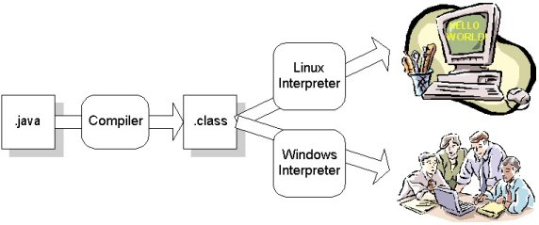
Interpreted
The Java compiler generates byte-codes, rather than native machine code. To actually run a Java program, you use the Java interpreter to execute the compiled byte-codes. Java byte-codes provide an architecture-neutral object file format. The code is designed to transport programs efficiently to multiple platforms.
rapid turn-around development
Software author is protected, since binary byte streams are downloaded and not the source code

Slide 20
Secure
Security is an important concern, since Java is meant to be used in networked environments. Without some assurance of security, you certainly wouldn't want to download an applet from a random site on the net and let it run on your computer. Java's memory allocation model is one of its main defenses against malicious code (e.g can't cast integers to pointers, so can't forge access). Furthermore:
access restrictions are enforced (public, private)
byte codes are verified, which copes with the threat of a hostile compiler
Architecture-Neutral
compiler generates bytecodes, which have nothing to do with a particular computer architecture
easy to interpret on any machine
Multithreaded
Java allows multiple concurrent threads of execution to be active at once. This means that you could be listening to an audio clip while scrolling the page and in the background downloading an image. Java contains sophisticated synchronization primitives (monitors and condition variables), that are integrated into the language to make them easy to use and robust. The java.lang package provides a Thread class that supports methods to start, run, and stop a thread, and check on its status.

Slide 21
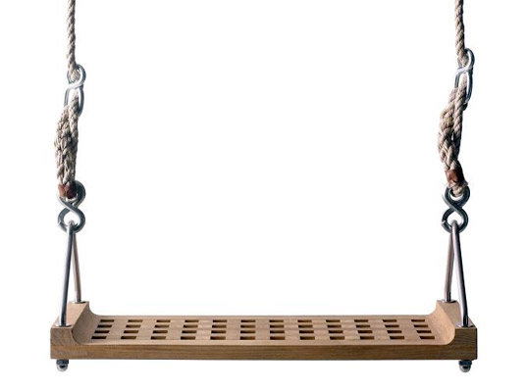
SWINGS
Swing is the primary Java GUI widget toolkit. It is part of Oracle's Java Foundation Classes (JFC) — an API for providing a graphical user interface (GUI) for Java programs.
Swing was developed to provide a more sophisticated set of GUI components than the earlier Abstract Window Toolkit (AWT).
Swing provides a native look and feel that emulates the look and feel of several platforms, and also supports a pluggable look and feel that allows applications to have a look and feel unrelated to the underlying platform.
It has more powerful and flexible components than AWT. In addition to familiar components such as buttons, check boxes and labels, Swing provides several advanced components such as tabbed panel, scroll panes, trees, tables, and lists.

Slide 22
RELATIONSHIP WITH AWT
Since early versions of Java, a portion of the Abstract Window Toolkit (AWT) has provided platform-independent APIs for user interface components. In AWT, each component is rendered and controlled by a native peer component specific to the underlying windowing system.
By contrast, Swing components are often described as lightweight because they do not require allocation of native resources in the operating system's windowing toolkit. The AWT components are referred to as heavyweight components.^{[according to whom?]}
Much of the Swing API is generally a complementary extension of the AWT rather than a direct replacement. In fact, every Swing lightweight interface ultimately exists within an AWT heavyweight component because all of the top-level components in Swing (JApplet, JDialog, JFrame, andJWindow) extend an AWT top-level container.

Slide 23
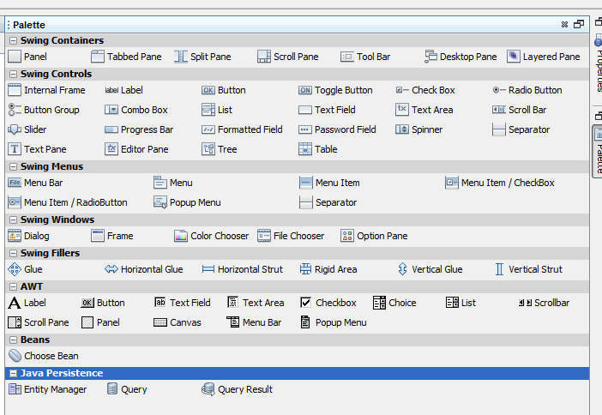
COMPONENTS OF SWINGS

Slide 24
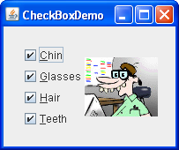
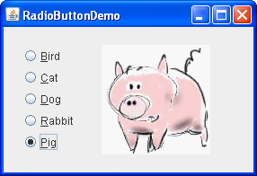
FUNCTIONS OF DIFFERENT SWING COMPONENTS
CHECK BOX
Swing check boxes have all the usual button characteristics. Check boxes are similar to radio buttons but their selection model is different, by convention. Any number of check boxes in a group — none, some, or all — can be selected.
2. RADIO BUTTON
A radio button or option button is a type of graphical user interface element that allows the user to choose only one of a predefined set of options. Radio buttons are arranged in groups of two or more and displayed on screen

Slide 25
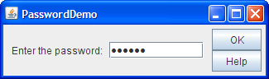

3.Password field
The JPasswordField class, a subclass of JTextField, provides specialized text fields for password entry. For security reasons, a password field does not show the characters that the user types. Instead, the field displays a character different from the one typed, such as an asterisk '*'.
4.Textfield
A text box, text field or text entry box is a kind of widget used when building a graphical user interface (GUI). A text box's purpose is to allow the user to input text information to be used by the program. User-interface guidelines recommend a single-line text box when only one line of input is required, and a multi-line text box only if more than one line of input may be required

Slide 26
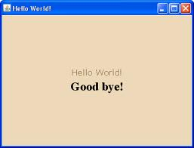
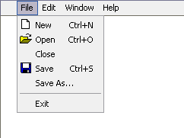
5.label
A label is a user interface control which displays text on a form. It is usually a static control; having no interactivity. A label is generally used to identify a nearby text box or other widget.
6.menu
In computing and telecommunications, a menu is a list of options or commands presented to an operator by a computer or communications system.

Slide 27

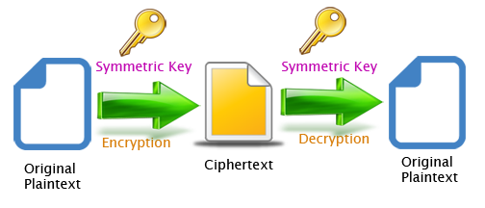
ENCRYPTION
DECRYPTION

Slide 28
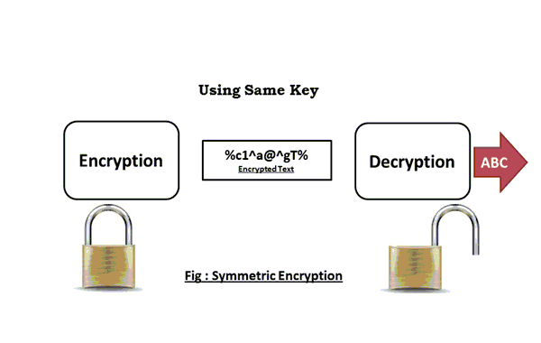
Cryptography (or cryptology; from Greek κρυπτός, "hidden, secret“) is the practice and study of techniques for secure communication in the presence of third parties (called adversaries).^{[2]}
More generally, it is about constructing and analyzing protocols that overcome the influence of adversaries^{[3]} and which are related to various aspects in information security such as data confidentiality, data integrity, authentication, and non-repudiation.^{[4]}
Modern cryptography intersects the disciplines of mathematics, computer science, and electrical engineering. Applications of cryptography include ATM cards, computer passwords, and electronic commerce.

Slide 29
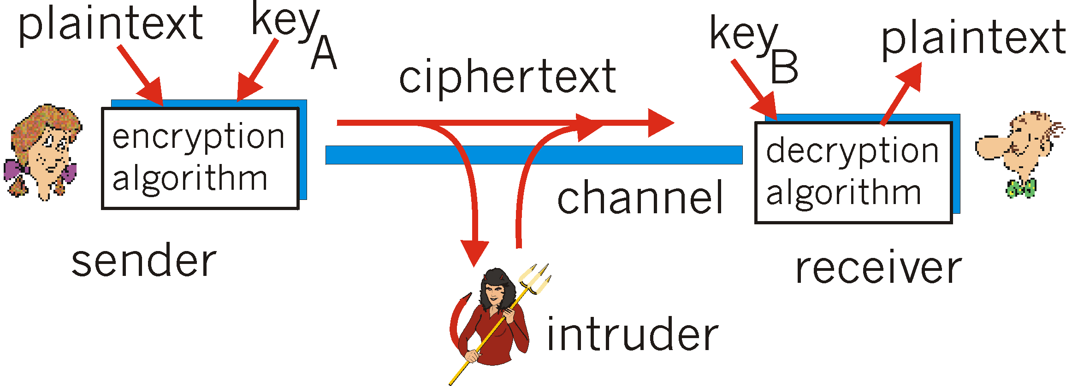
Until modern times cryptography referred almost exclusively to encryption, which is the process of converting ordinary information (called plaintext) into unintelligible text (called cipher text).^{[7]}Decryption is the reverse, in other words, moving from the unintelligible cipher text back to plaintext..
Cryptanalysis is the term used for the study of methods for obtaining the meaning of encrypted information without access to the key normally required to do so; i.e., it is the study of how to crack encryption algorithms or their implementations.

Slide 30

APPLICATIONS OF CRYPTOGRAPHY
DATA AND TELECOMMUNICATIONS, cryptography is necessary when communicating over any untrusted medium, which includes just about any network, particularly the Internet.
SECRET BROADCAST secret broadcast is, simply put, a broadcast that is not for the consumption of the general public.
TO KEEP THINGS CONFIDENTIAL - Confidentiality is a set of rules or a promise that limits access or places restrictions on certain types of information.
PASSWORD is a secret word or string of characters used for user authentication to prove identity or access approval to gain access to a resource (example: an access code is a type of password), which should be kept secret from those not allowed access.
ELECTRONIC COMMERCE, commonly known as e-commerce or eCommerce, is a type of industry where the buying and selling of products or services is conducted over electronic systems such as the Internet and other computer networks.
MATRIX-One type of code, which is extremely difficult to break, makes use of a large matrix to encode a message. The receiver of the message decodes it using the inverse of the matrix. This first matrix is called the encoding matrix and its inverse is called the decoding matrix.

Slide 31

Why I choose this project
CRYPTOGRAPHY IS THE PRACTICE AND STUDY OF TECHNIQUES FOR SECURE COMMUNICATION IN THE PRESENCE OF THIRD PARTIES.DATA INTEGRITY AND AUTHENTICATION HAS BECOME A MAJOR ISSUE IN TODAYS COMPUTER WORLD, TO PREVENT DATA THEFT IN CORPORATE AND FOR SECURE COMMUNICATION IN ARMED FORCES AS WELL BANKING TRANSACTIONS.

Slide 32
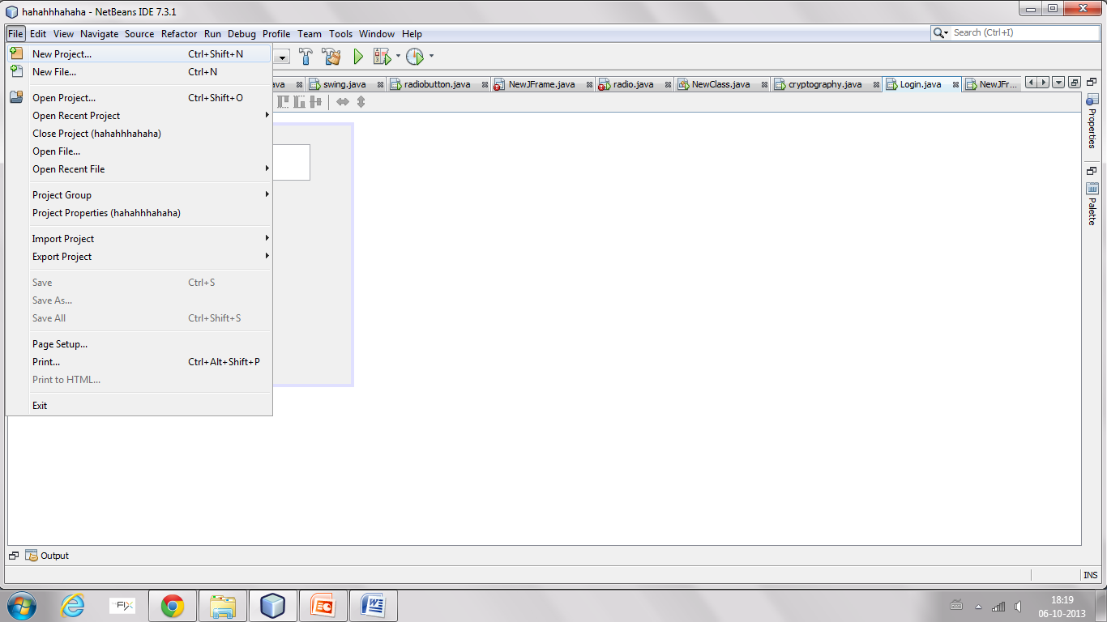
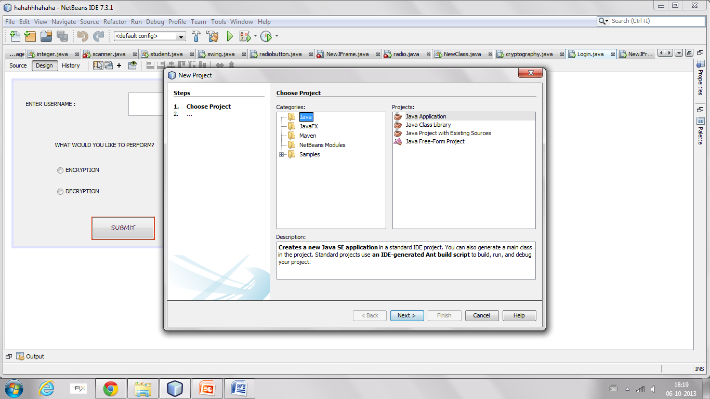
How to make a new project and add frame to it
Click on file->new project
Select category as java->java application

Slide 33
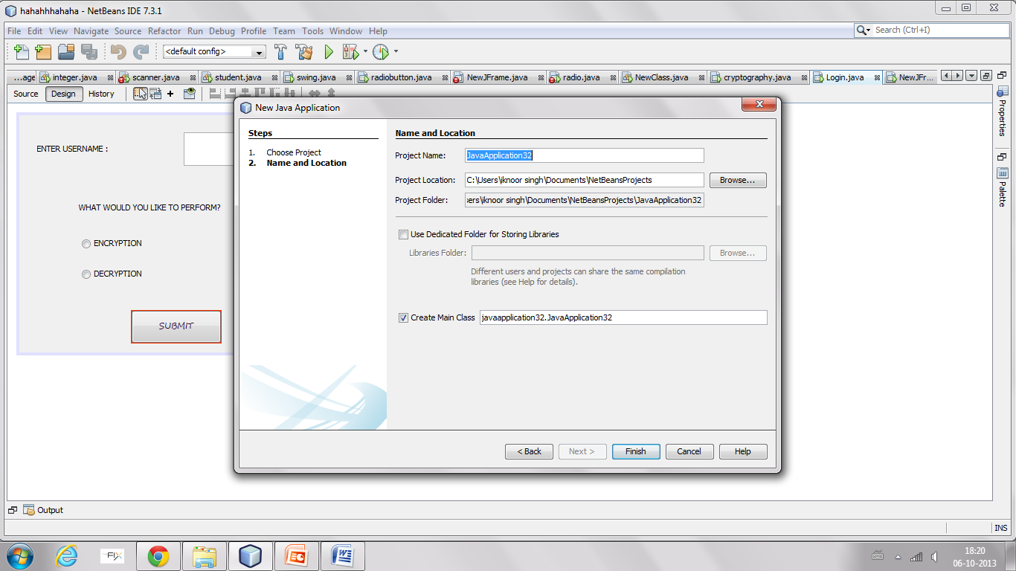
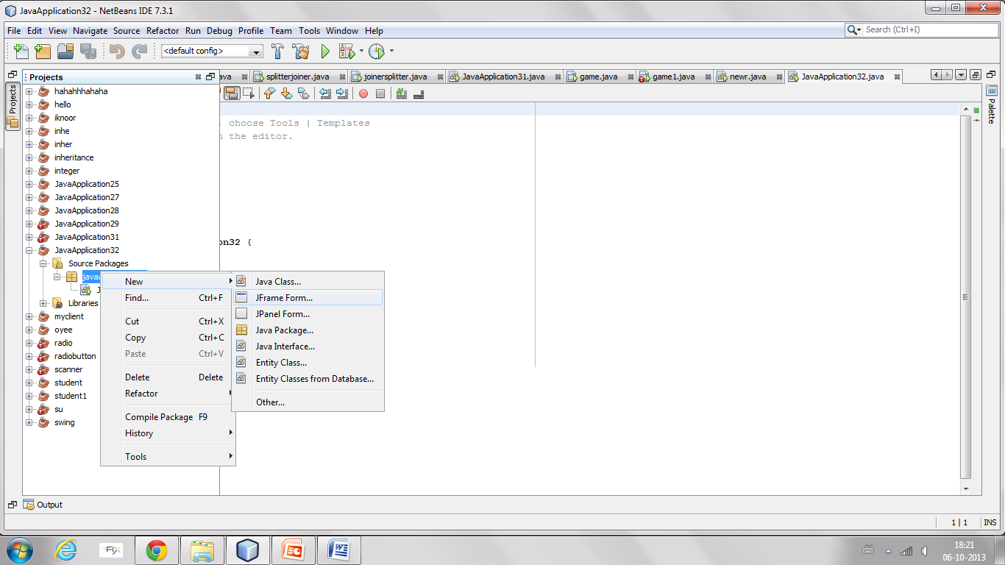
WRITE THE NAME OF THE PROJECT IN THE FIELD PROVIDED
RIGHT CLICK ON THE PROJECT NAME AND CLICK NEW THEN CLICK JFRAMEFORM

Slide 34
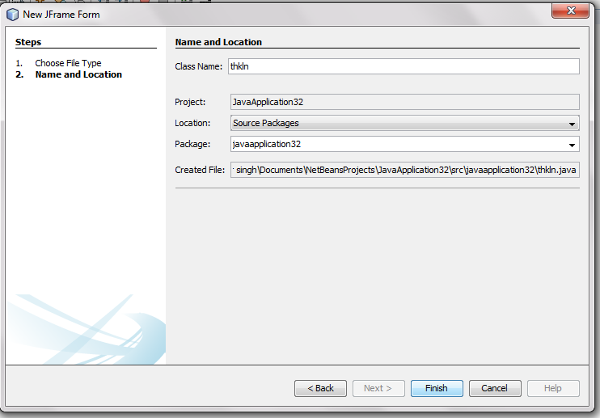
CLICK ON FINISH
FINALLY THE FRAME IS ADDED TO THE PROJECT

Slide 35
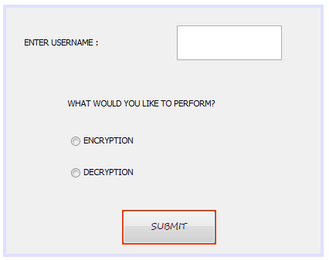
INTERACTION WITH THE PROJECT
Steps:
ENTER THE USERNAME IN THE TEXT FIELD PROVIDED
SELECT ONE OPTION TO BE PERFORMED i.e ENCRYPTION OR DECRYPTION
FINALLY CLICK THE SUBMIT BUTTON GIVEN BELOW

Slide 36
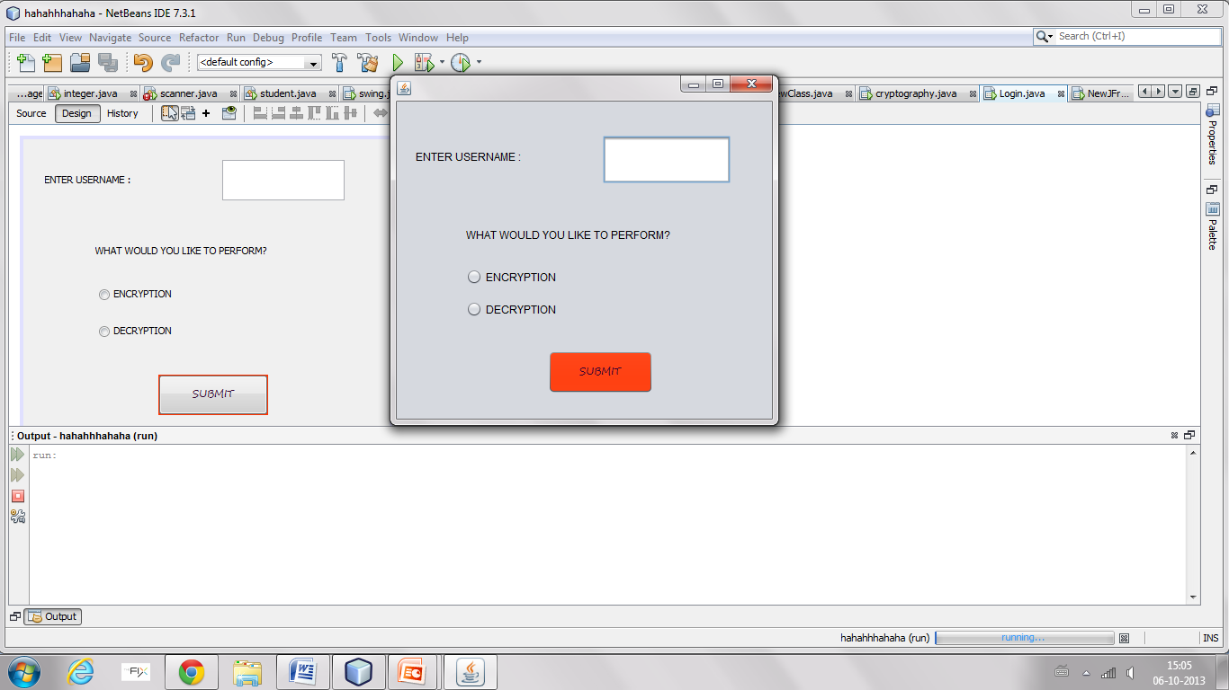
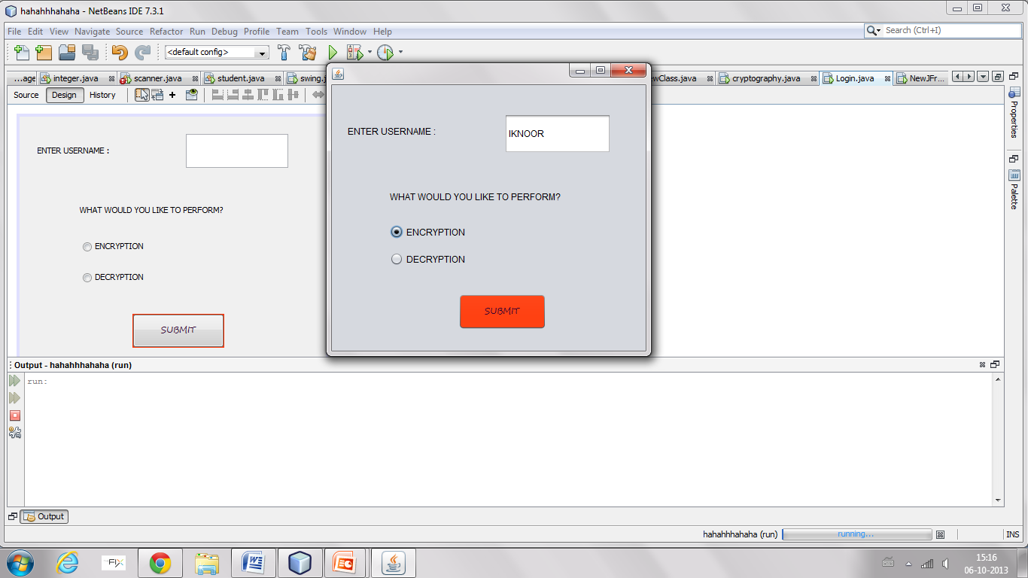
LOGIN PAGE

Slide 37
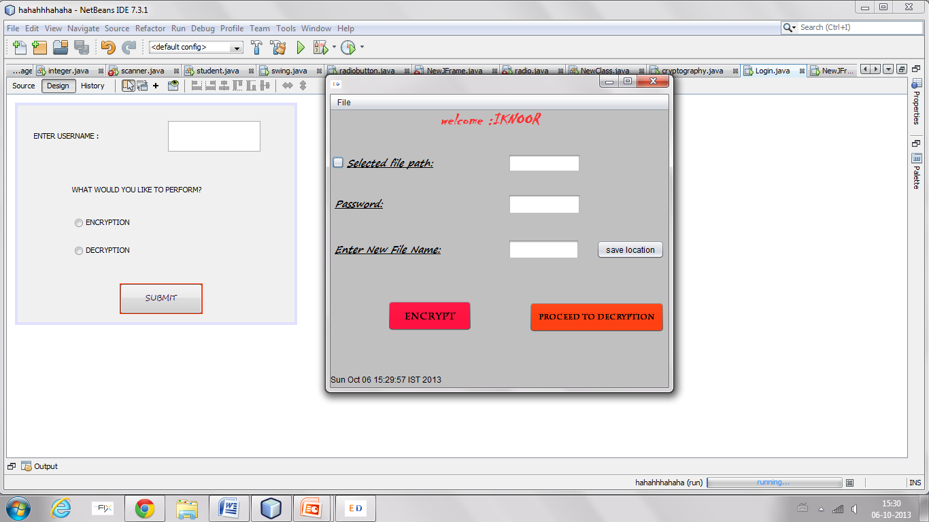
MENU BAR
USERNAME
TEXTFIELD
FRAME
ICON IMAGE
CHECK BOX
DATE
BUTTON USED TO ENCRYPT
BUTTON USED FOR DECRYPTION

Slide 38
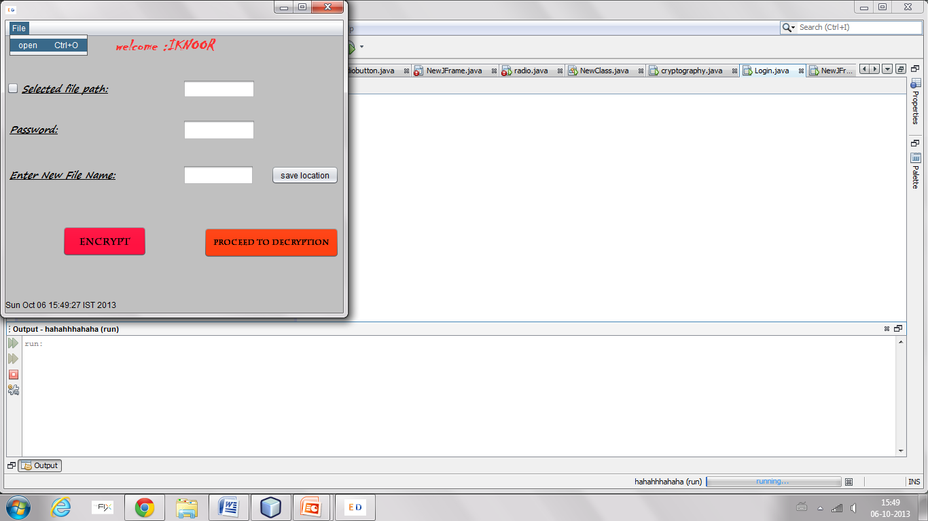
CLICK ON FILE MENU
THEN CLICK ON THE MENU ITEM OPEN(SHORTCUT CTRL+O)

Slide 39
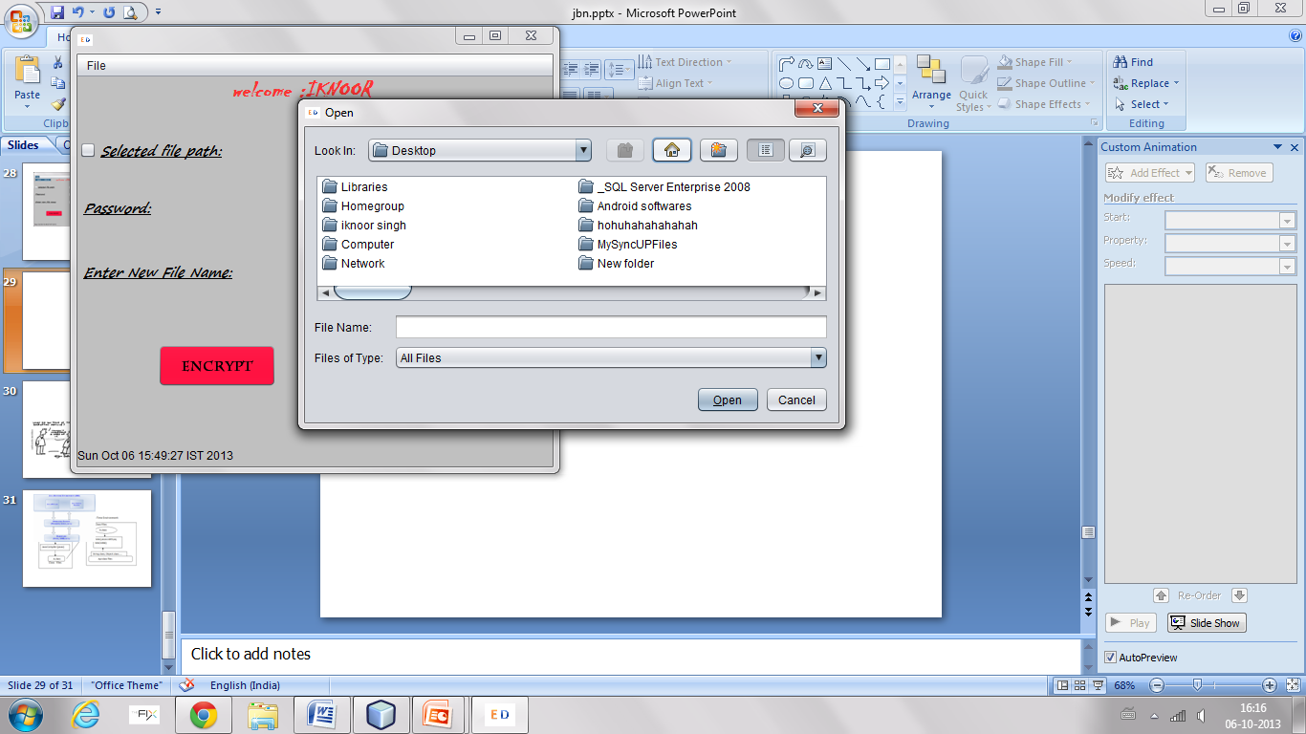
AFTER CLICKING ON
OPEN ,SHOW DIALOG BOX IS DISPLAYED
CHOOSE THE FILE TO BE ENCRYPTED FROM THE DIALOG BOX
SHOW OPEN DIALOG

Slide 40
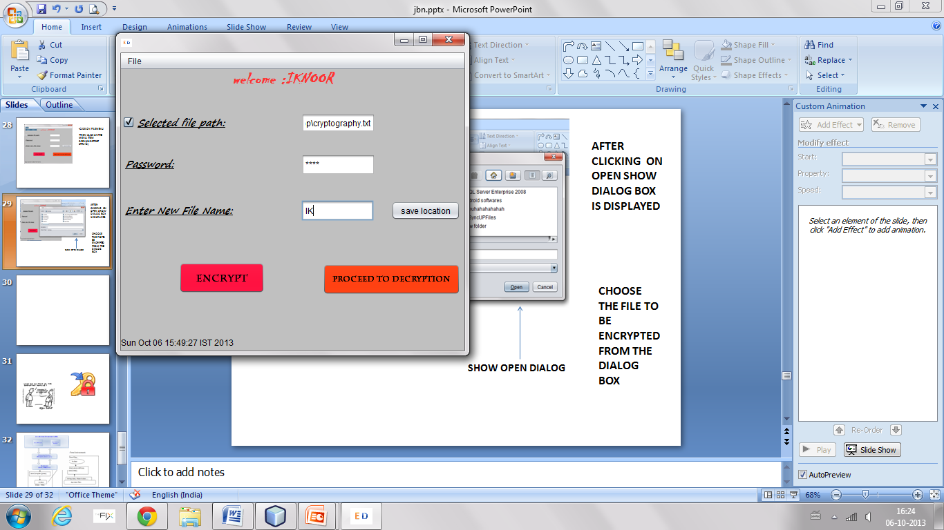
CLICK ON THE CHECK BOX AND THE PATH OF THE FILE APPEARS IN THE JTEXTFIELD
ENTER THE PASSWORD IN THE PASSWORDFIELD WHICH SHOULD NOT BE GREATER THAN 4 DIGITS
ENTER THE NEW FILE NAME WHICH WILL CONTAIN THE ENCRYPTED DATA

Slide 41
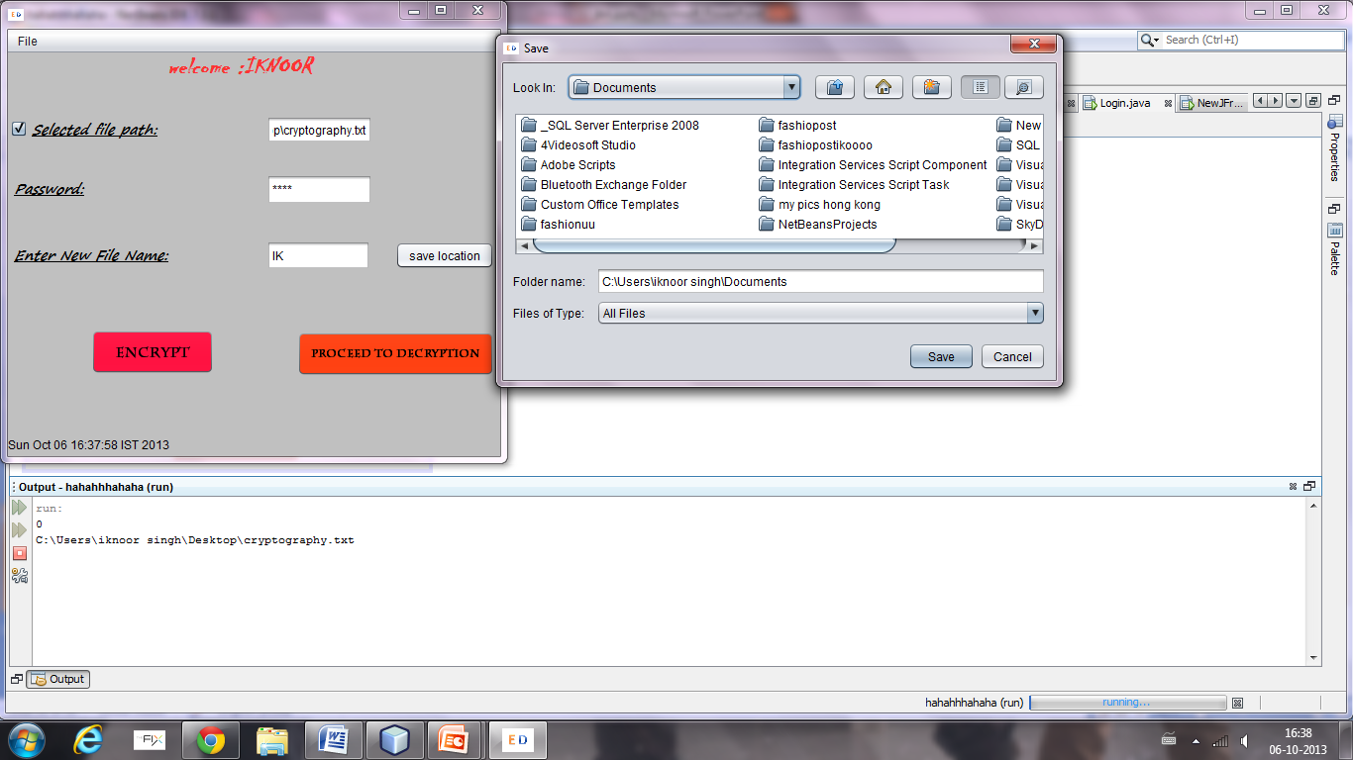
AFTER ENTERING THE NAME OF THE NEW FILE CLICK ON SAVE LOCATION BUTTON WHICH OPENS A SAVE DIALOG BOX FROM WHERE WE CAN CHOOSE A SPECIFIC LOCATION
THEN CLICK ON SAVE

Slide 42
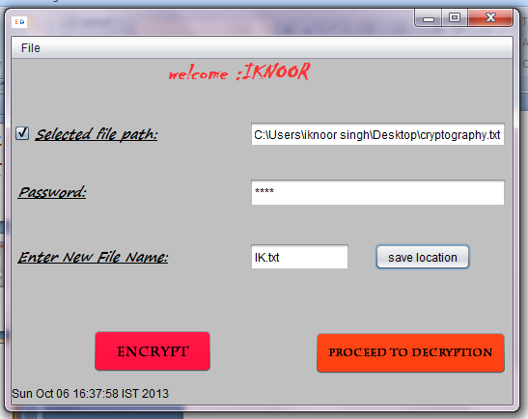
NEXT CLICK ON THE ENCRYPT BUTTON SO THAT THE DATA OF THE FILE GETS ENCRYPTED AND IS SAVED INTO THE NEW FILE
THE EXTENSION OF THE SELECTED FILE IS COPIED TO THE NEW FILE NAME SO THAT THE TYPE OF ENCRYPTED FILE SHOULD BE SAME

Slide 43
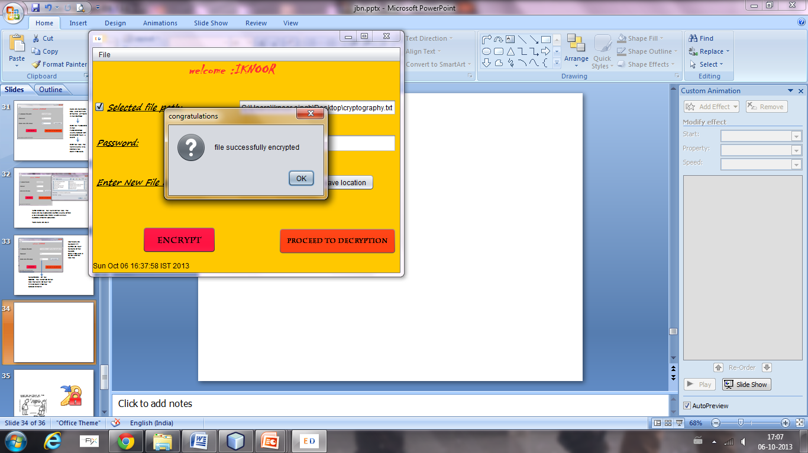
JOPTIONPANE DIALOG SHOWS THAT THE FILE HAS BEEN ENCRYPTED FINALLY
COLOR OF THE FRAME CHANGED TO YELLOW AT THE CLICK OF ENCRYPT BUTTON
THE ENCRYPTED FILE CAN BE SEEN AT THE LOCATION SPECIFIED IN THE SAVE LOCATION BUTTON

Slide 44
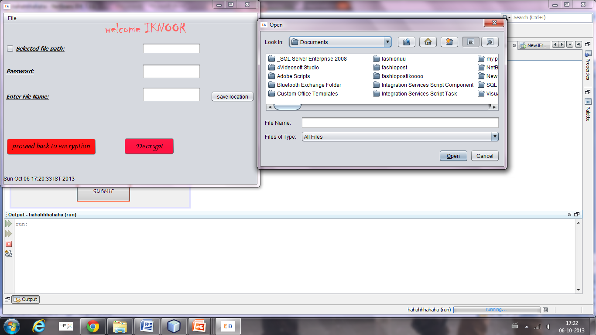
CLICK ON “PROCEED TO DECRYPTION” BUTTON IN THE ENCRYPTION FRAME
DECRYPTION FRAME APPEARS
CLICK ON FILE (MENU BAR) OPEN DIALOG BOX APPEARS
SELECT THE FILE TO BE DECRYPTED

Slide 45
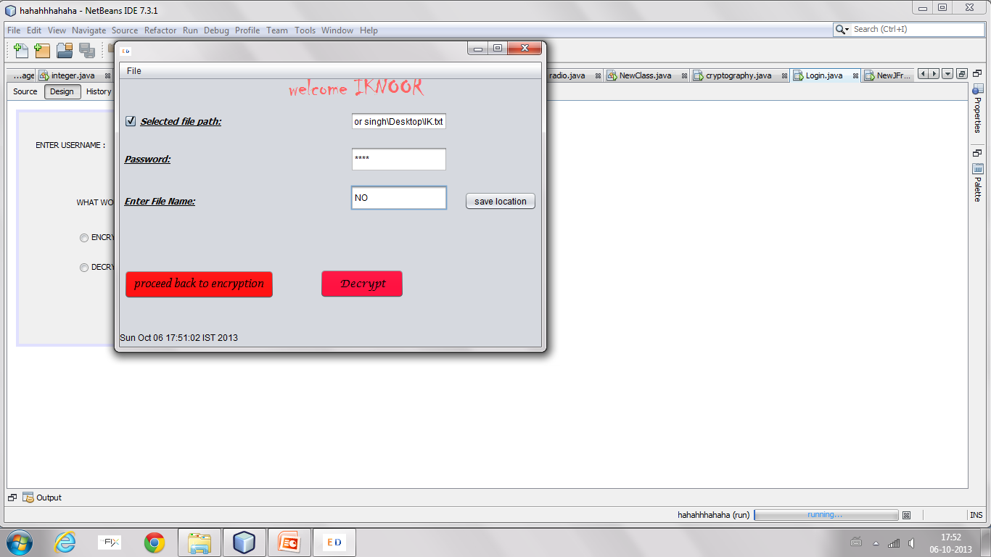
PATH OF THE ENCRYPTED FILE TO DECRYPTED
THIS PASSWORD SHOULD MATCH THE ENCRYPTEDPASSWORD
NAME OF THE DECRYPTED FILE

Slide 46
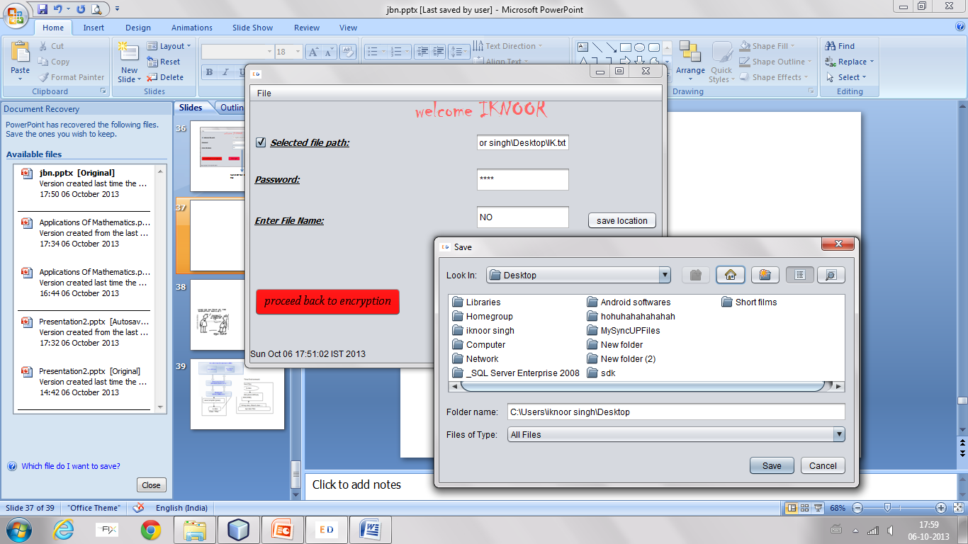
NEXT CLICK ON THE SAVE LOCATION BUTTON TO SPECIFY THE LOCATION OF THE DECRYPTED FILE WHERE THE USER WANTS IT TO BE SAVED.

Slide 47
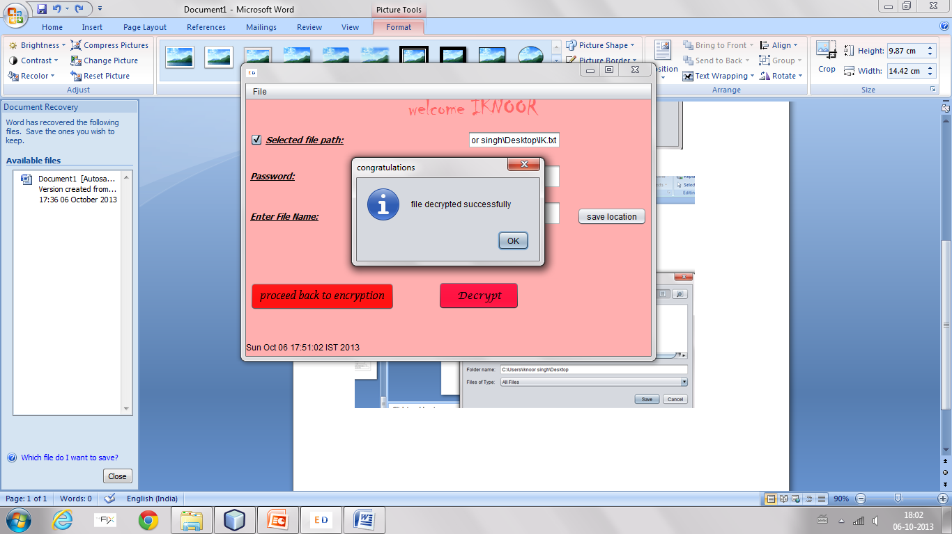
JOPTION PANES SHOWS THE MESSAGE THAT THE FILE IS DECRYPTED SUCCESSFULLY
WITH THE CLICK OF THE DECRYPT BUTTON THE COLOR OF THE FRAME CHANGES TO PINK

Slide 48
RESULT AND CONCLUSION
Cryptography is a software used for conversion of data in a text,doc,image file to cipher text (non readable form) ,this process is know as encryption. Whereas decryption is a process of conversion of cipher text back to the original text by using a unique key(password)to protect data integrity.
We have seen it practically that the cryptography program here is used to encrypt the data in a file and store it in another file and get the original data back by using decryption process.

Slide 49
REFERENCES
http://cs.brown.edu/courses/cs016/docs/oldlectures/Crypto3.pdf
http://m.download.cnet.com
http://www.tutorialspoint.com
http://www.docs.oracle.com
http://en.m.wikipedia.org

Slide 50


